Slide 1

Spatio-Temporal Neural Coding and WLC Principle: From Experiments to Understanding
Misha Rabinovich
Institute for Nonlinear Science
University of California, San Diego
Notes:
F

Slide 2
The Goal
Transformation of the identity neural code to the identity-temporal code and the generation of stimulus dependent sequential activity are important functions of many neural systems (CPGs, Sensory
systems, Hippocampus etc.).
We suggest a WinnerLess Competition (WLC) principle can be the basis for such dynamical behavior of neural ensembles.
I am going to present a few examples that demonstrate how the WLC principle works.
I will also present some rigorous results that show the structural stability of WLC dynamics.
Discuss briefly the advantage of WLC activity.

Slide 3
Four examples of spatio-temporal coding & sequential neural activity
Olfactory System: Stimulus dependent identity- temporal coding in Antennal Lobe
Clione’s hunting behavior
Songbird: Generation of the spatiotemporal patterns for songs
Hippocampus: Spatial sequential memory, dynamics of the “place cells” ensemble

Slide 4
Questions
What are the dynamical principles that underlie
the sequential activity of complex neural ensembles ?
How are the network connections related to informational patterns in neurodynamics?
Is it possible for a neural system to solve the fundamental contradiction between reproducibility of an informational pattern and sensitivity?
If “Yes”, how ? We discuss here the
WinnerLess Competition (WLC) principle

Slide 5
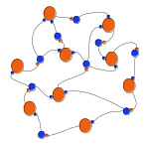
WLC Principle
input
output
1
1
1
0
2
2
1
8
8
0
9
9
Time
1
0
0
Transformation of the identity
input Into spatio-temporal
output based on the intrinsic
switching dynamics of the
Neural ensemble
0
1
0
0
0
1
1
1
0

Slide 6
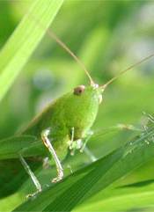
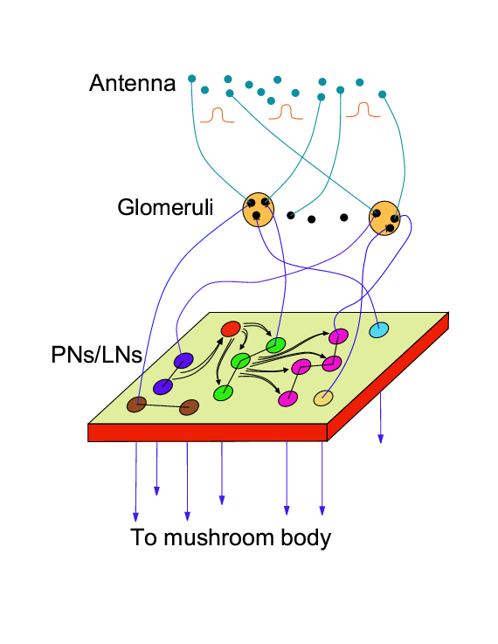
Spatio-temporal coding in the Antennal Lobe of Locust
(space = odor space)
Lessons from the
experiments:
The key role of the
inhibition
Nonsymmetric
connections
Weak excitation
between PNs

Slide 7
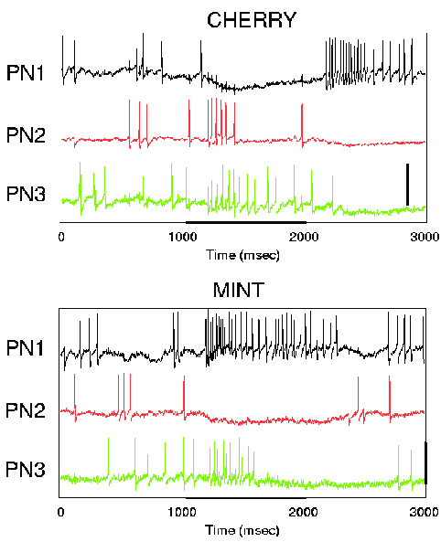
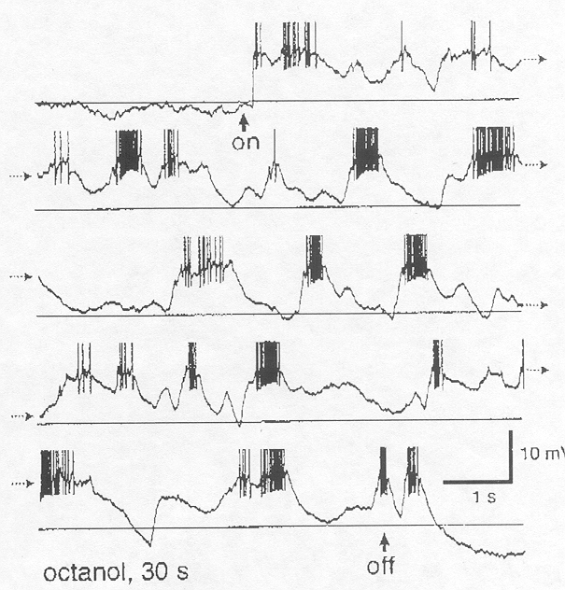
Examples of the spatio-temporal patterns in the olfactory system
Locust

Slide 8
Dynamical system approach
Reproducible Sequential
stimulus dependent dynamics in
spatio-temporal neural
representation ensemble
System has to be strongly dissipative
Can’t be multistable
Has to have stable manifold

Slide 9
Hierarchy of the Models
Network with realistic H-H model neurons & random inhibitory & excitatory connections
Network with FitzHugh-Nagumo spiking neurons
Lotka-Volterra type model for spiking rate of the Principal Neurons (PNs)

Slide 10
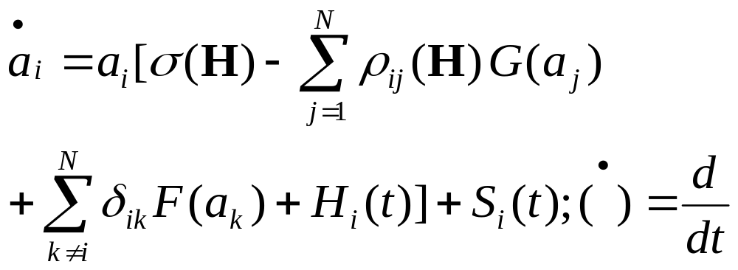

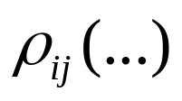



Basic Rate Model
Is the furring rate of neuron i
is the strength of inhibition in i by j
is the strength of excitation in i by k
is the excitation from the other neural ensembles
is an external actions

Slide 11
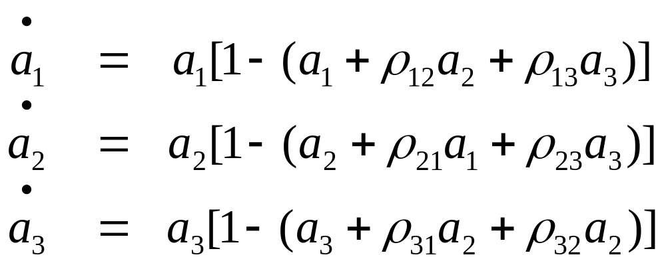
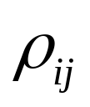
Role of nonsymmetric connections
Lotka-Volterra model of population dynamics
are competition coefficients
When, for example,
WLC dynamics is guaranteed

Slide 12
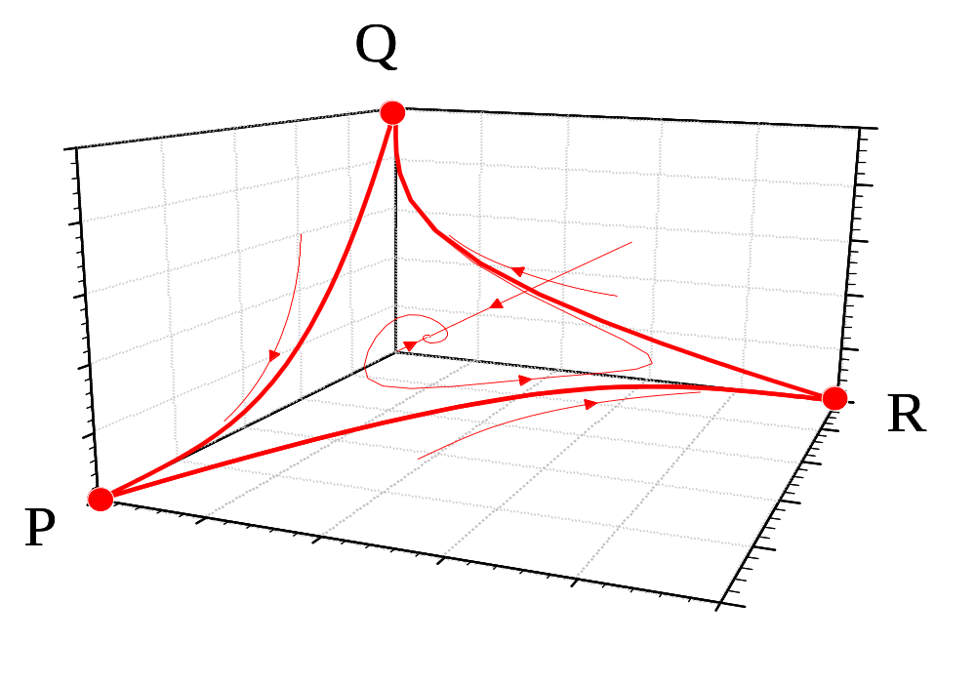
WLC Principle
Geometrical image of the switching activity in the phase space is the orbit in the vicinity of the heteroclinic contour

Slide 13
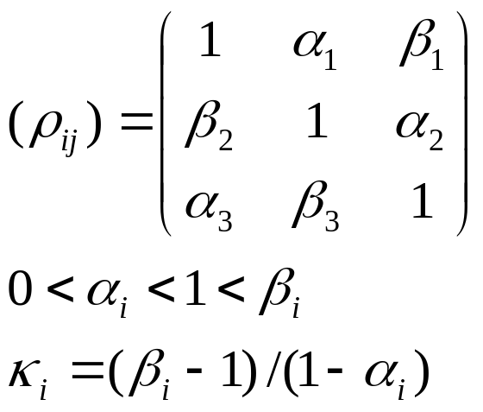
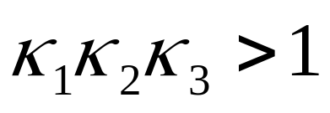
Canonical Lotka-Volterra model Rigorous results (N=3)
Then the heteroclinic contour is a global attractor if
A noise transfer the
heteroclinic contour to a stable limit cycle with the same order of a sequential switching
Consider the matrix

Slide 14
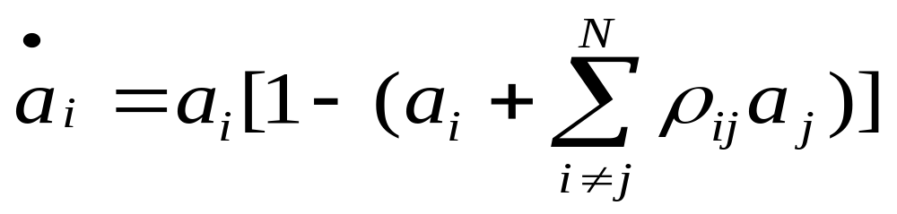
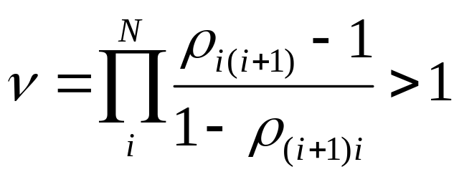
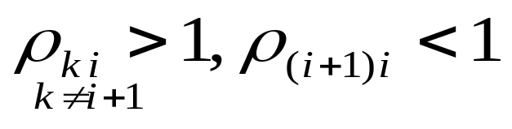
Canonical L-V model (N>3)
A heteroclinic contour consists of finitely many saddle equilibria and finitely many separatrices connecting these equilibria. The contour can serve as an attracting set if every saddle point has only one unstable direction. Condition
for this is:
i
i+1
For
stability:

Slide 15
WLC in complex neural ensembles
Complex network = many elements +
+ disordered connections
Most important phenomena in complex
systems on the edge of reproducibility are:
(i) clustering, and
(ii) competition

Slide 16
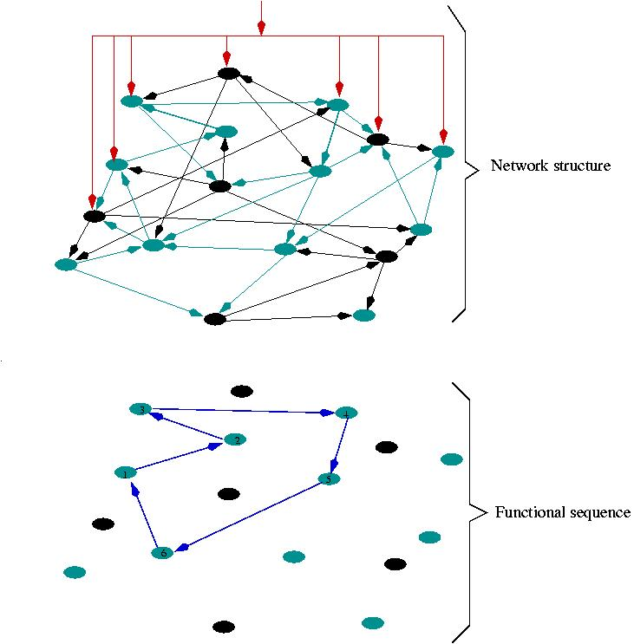
Network of H-H neurons with random slow inhibitory connections

Slide 17
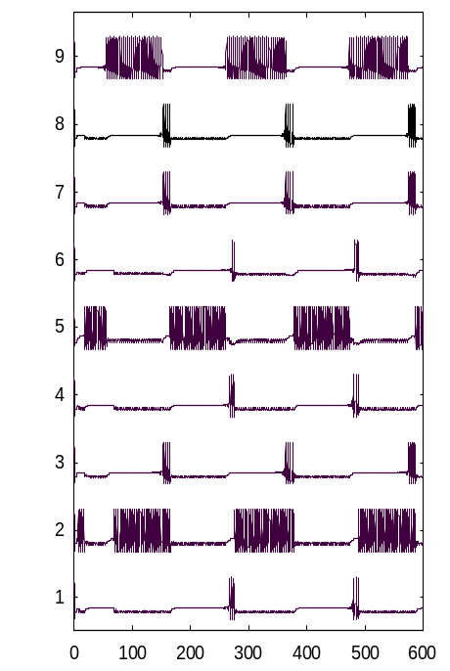
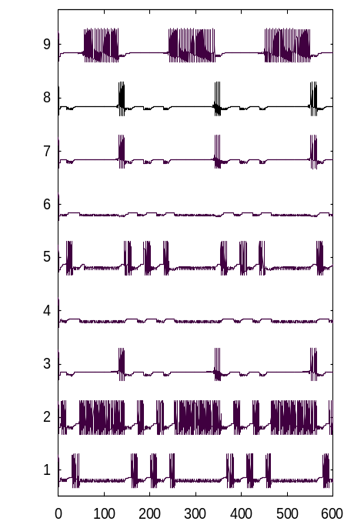
WLC : Results of modeling
Dynamics of Locust AL model
Odor1
Odor2
Neuron
Neuron
Time
Time

Slide 18
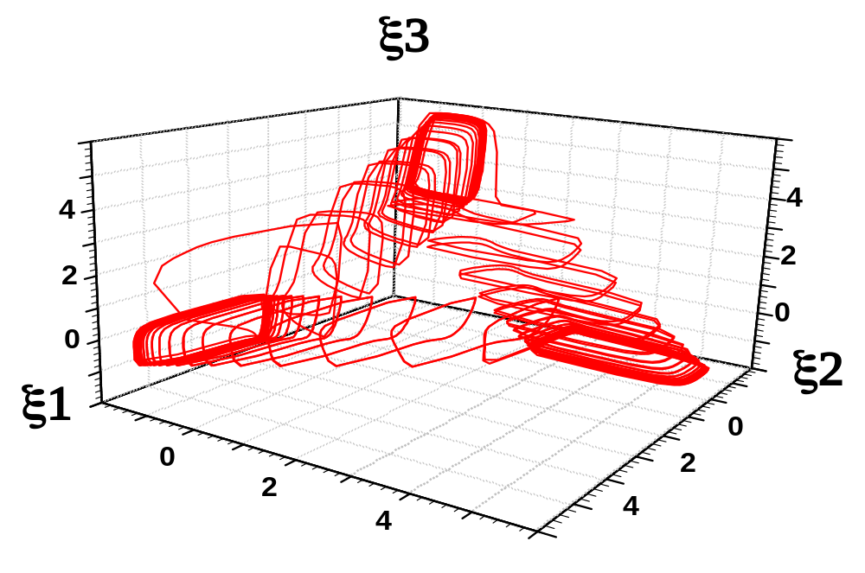
WLC Principle
Geometrical image of the switching activity in the phase space is the orbit in the vicinity of the heteroclinic contour

Slide 19
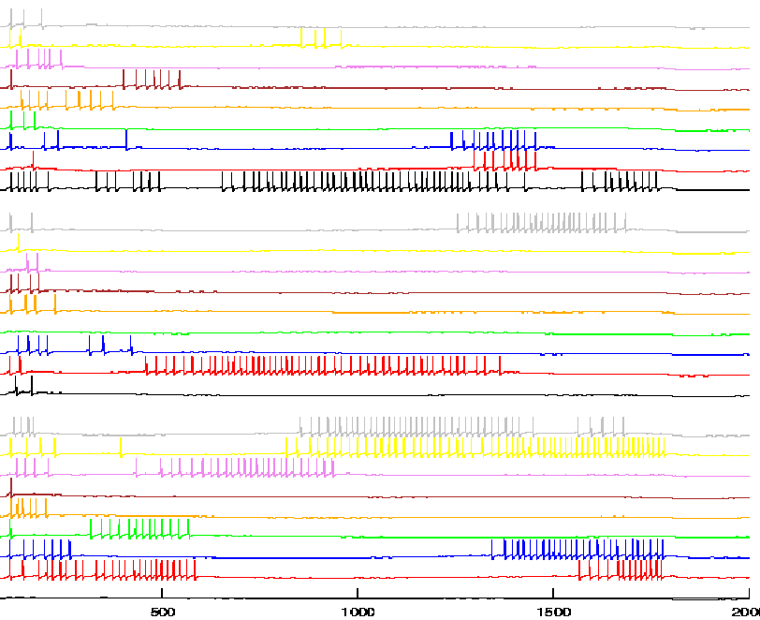
WLC: Dynamics of the H-H network
Neuron
time (ms)

Slide 20
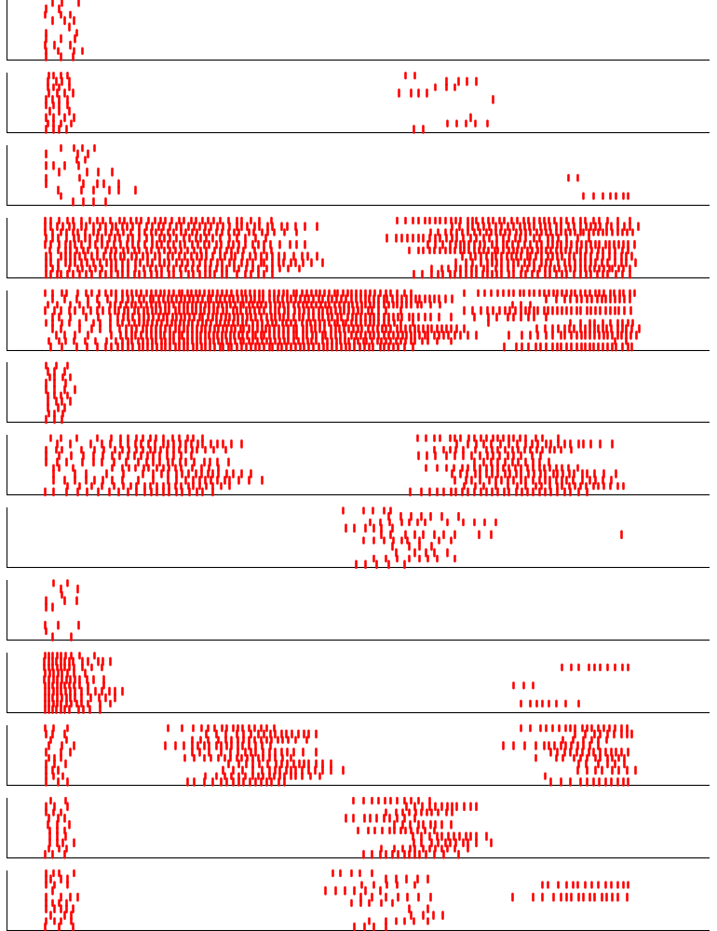
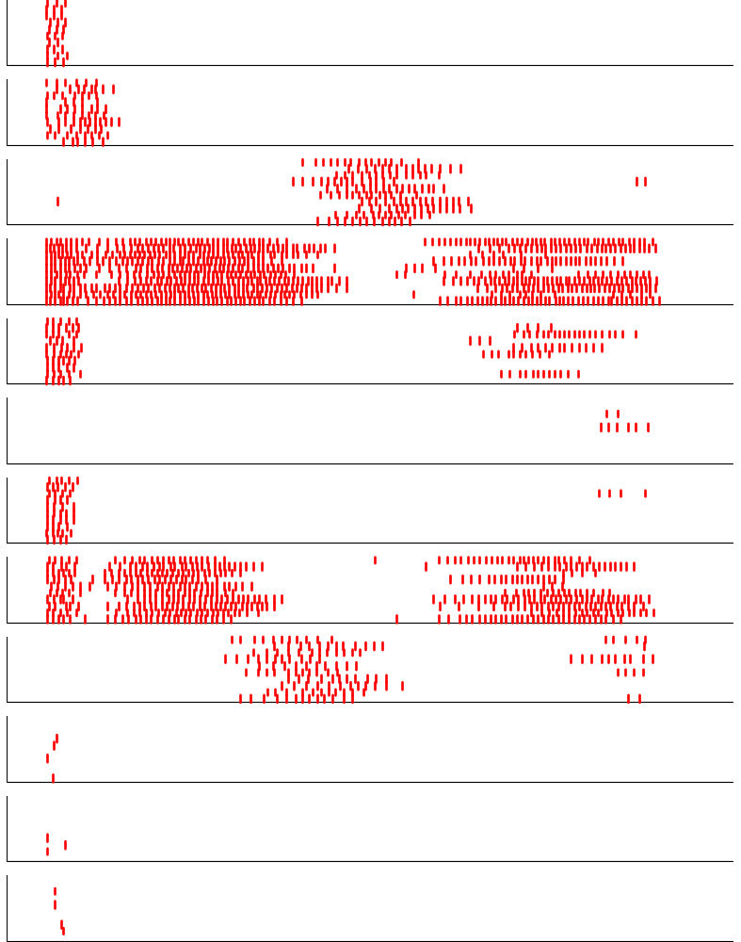
Reproducibility of the dynamics
1
} – 10 trials
14
2
15
3
16
4
17
5
18
6
19
7
20
8
21
9
22
10
11
23
12
24
13
25
time
time

Slide 21
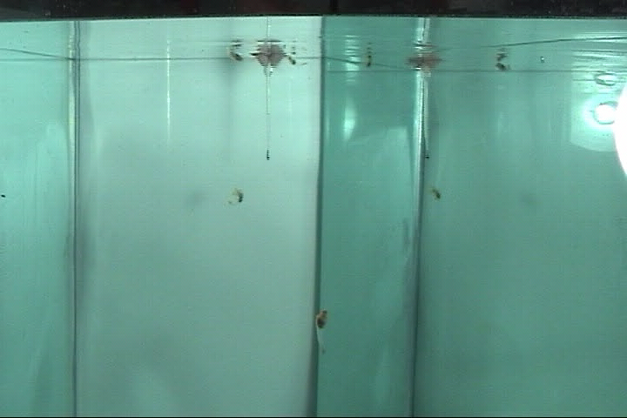

Slide 22
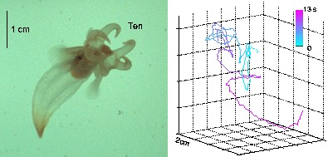
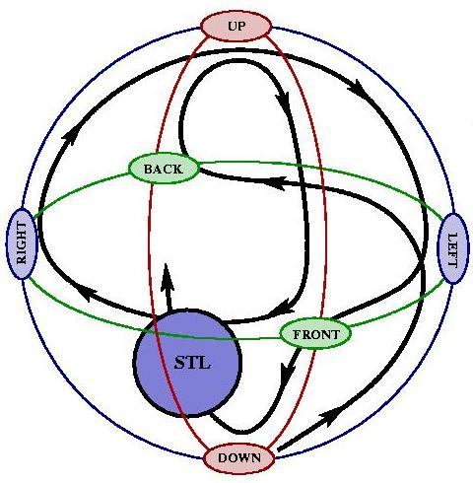
Clione’s hunting behavior
Statocyst is Clione’s gravimetric organ

Slide 23
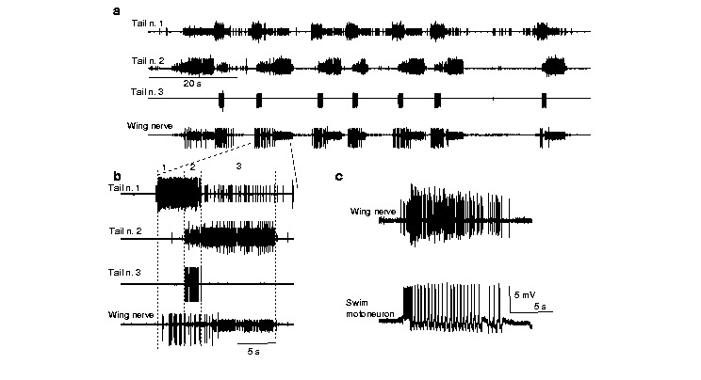
Spatio-temporal patterns in Clione’s nerves

Slide 24
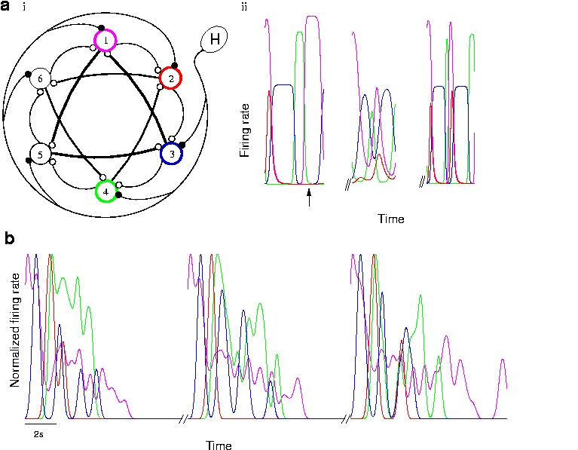
Clione’s statocyst dynamics
Statocycst model neurons activity
Tail moto-neurons activity

Slide 25
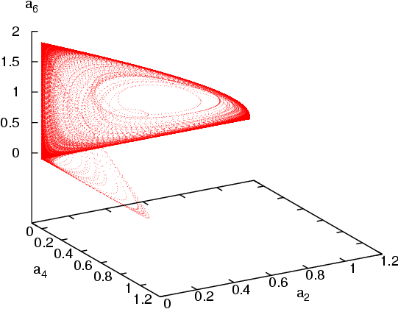
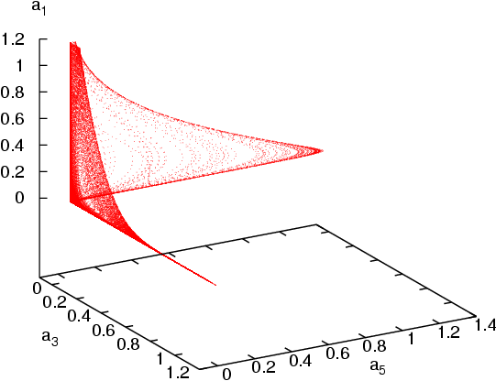
Projection of the strange attractor from the 6D phase space of the statocyst network

Slide 26
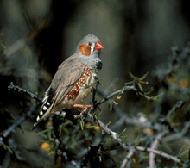
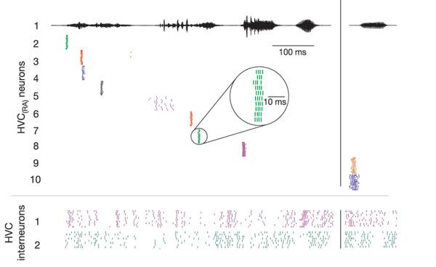
Songbird patterns

Slide 27
The main message
The WLC principle does not depend on the level of neuron & synapse description and can be realized by
many different kinds of network architecture.
The WLC principle is able to solve a fundamental contradiction between stability & sensitivity.
The WLC is a new paradigm for coding machines.

Slide 28
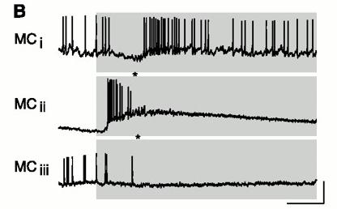
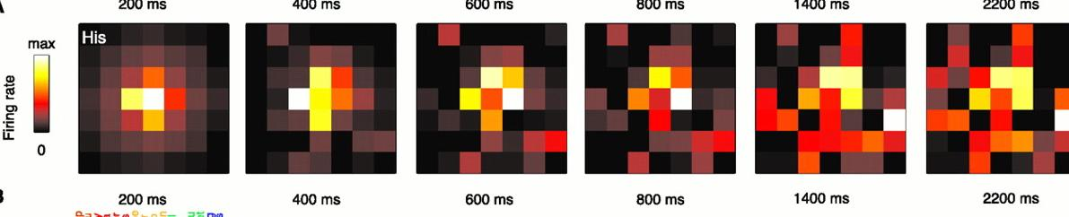
Advantage
Odor representation in zebrafish olfactory balb
The dynamics of the OB (AL)
amplified initial differences
between the representations
of chemically similar odorants

Slide 29
Thanks to the collaborators
OLFACTORY SYSTEM
Ramon Huerta
Alex Volkovskii
Valentin Zhigulin
Henry Abarbanel
Gilles Laurent
CLIONE
Rafael Levi
Pablo Varona
Yuri Arshavsky
Allen Selverston
SONGBIRD
Ramon Huerta
Marta Garcia-Sanches
THEOREMS
Valentin Afraimovich

Slide 30

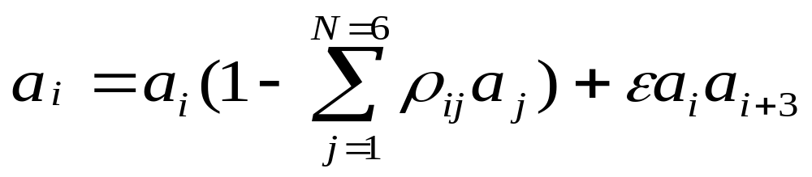
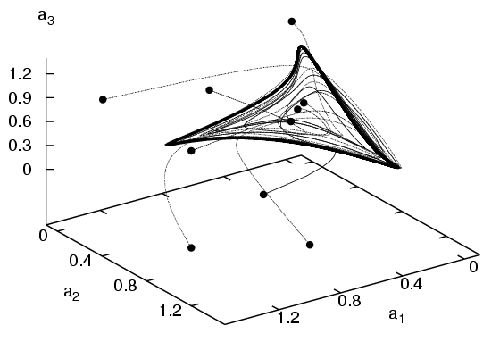
Weak reciprocal excitation stabilizes WLC dynamics: Birth of the stable limit cycle in the vicinity of the former heteroclinic contour

Slide 31
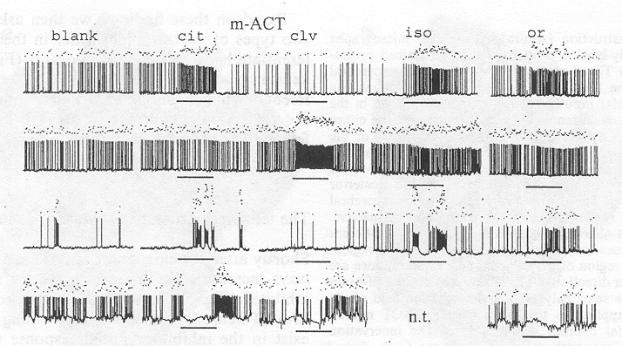
Examples of the Spatio-temporal
Patterns in the Olfactory Systems

